Slide 1
Domain Prep Session: PM
Team Disha | Summers 2022

Slide 2
Suggestive Timeline
Prepare HR answers CV prep Brush up technologies on CV Case Slots & Guesstimates | Practice General and ProdMan specific Guesstimates –TG channels Start cases from Disha resources Critically analyse applications Case Slots & Guesstimates | Case slots & Guesstimates Continue to practice cases – ProdMan TG, Disha resources Follow any technology related happenings | Refine HR answers Extensive CV prep Revise cases and app analysis | Mock PIs Mock GDs Go through past experience from compendium Company specific prep Case Slots | JD & Role specific details Company related latest news
After PM 102 Session | PGP 2 exams and term break | Term 5 (PGP2) – Sep Week 2 | PGP 1 exams | Term Break to Day 0 | During placements

Slide 3
Company Processes at IIM-L
Application on Superset
Case Submission
Shortlists Released
Interview
(Submission based, Technical, Product Cases)
HR Interview

Slide 4
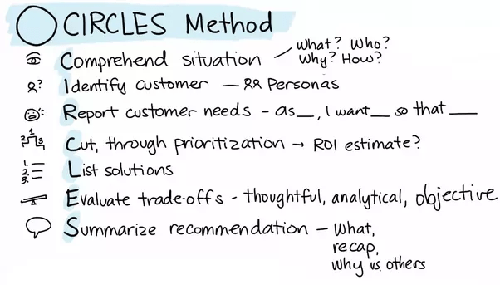
Case Frameworks
Improve LinkedIn
Improve? LinkedIn?
CX for LinkedIn’s Profile Page
Product? Need?
User Segment? Use Cases?
For job seekers
Wireframe! User Journey?
Solution at touchpoints
AARRR? Metrics?
Acquisition, Activation, Retention, Revenue, Referral
WHAT?
WHO?
HOW?
WHICH?

Slide 5
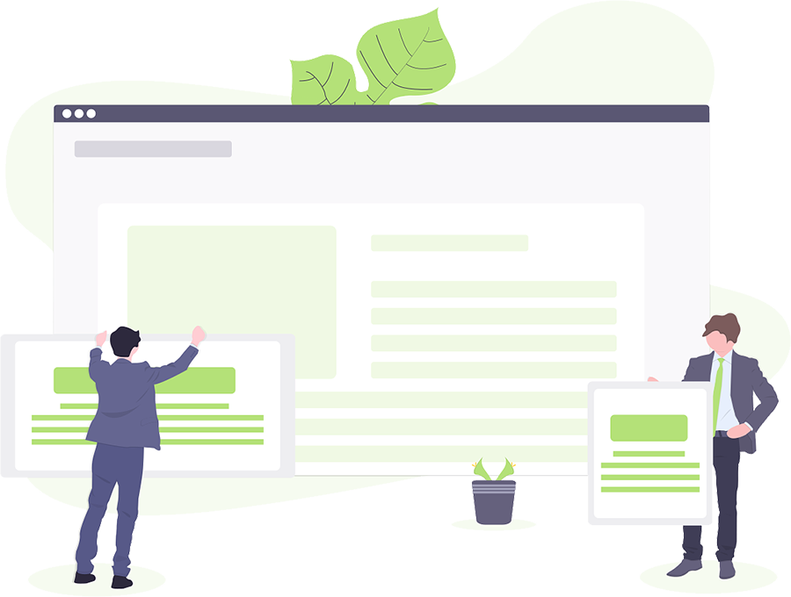
Case Type: Product Design/ Improvement

Slide 6
Design Uber for elderly
Open ended – clarify as much as possible
Word your questions well
Clarifying Questions
Objective to launch
Software or hardware device or physical setup
If physical setup – any specific geography
Which business vertical?
State your approach
Good idea to constantly check back with interviewer

Slide 7
Design Uber for elderly
User segments – State Characteristics
Prioritise customer base based on objective
Use objective - target market size etc.
Other constraints – time, budget etc.
Needs / pain-points

Slide 8

Exploring User Journey
Exploring User Journey
Break down user experience into the pages a user would traverse
Evaluate each page and its elements:
→Feature
→Layout
→performance
User journey:
Login
Home Page
Select Payment Method
Input Destination
Select Cab type
Confirmation & Tracking
Cab journey -Tracking
Pickup

Slide 9
Video Platform for Facebook
Solutions
Evaluate Trade-offs
Target achievement
Feasibility
Cost/timeline constraint
Evaluation Metrics

Slide 10
Evaluation Metrics
Acquisition
Users coming to the site from various channels
Activation
Users actively engaging with the platform. “Ahaa experience”
Retention
Users coming back multiple times – describes how well the business is doing
Revenue
Money generated against the acquisition costs incurred
Referral
Users are satisfied enough to recommend further

Slide 11
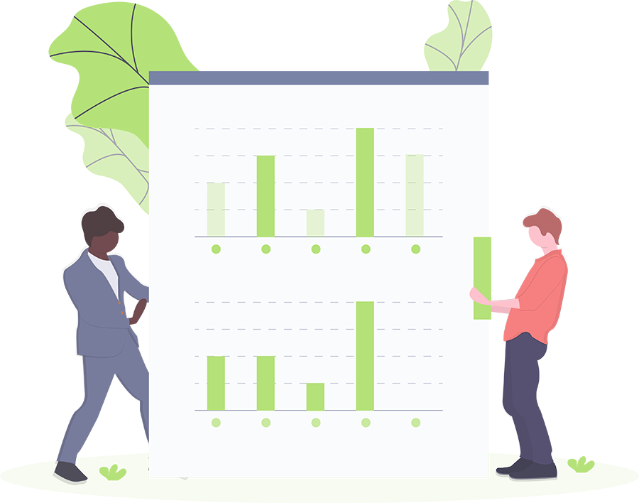
The Metrics
App
User Acquisition
User Activation
User Retention
Revenue
Referral
How to get more users on boarded?
- App downloads
- Mail conversions
- Search engine
- Geographical coverage
Are users actively using my app?
- No. of active sessions/user
- No. of searches
- New cart started
No. of transaction
Time spent
Are users retaining to my app?
- No. of active usage per month
- churn out rate
- cart abandonment
- order frequency
How can I monitor/ increase my revenue?
- Purchase per customer
- Revenue per customer or CLV*
- cost of sale/ shipping or CAC#
Are my users bringing more people onboard?
- Referral rate
- Net promoter score
- Viral coefficient
- Complain rate
*Customer Lifetime Value (CLV) = (Annual revenue per customer * Customer relationship in years) – Customer acquisition cost
#Customer Acquisition Cost (CAC) = (Total Marketing + Sales Expenses) / Number of New Customers Acquired

Slide 12
Case Type 2: New Product Launch

Slide 13
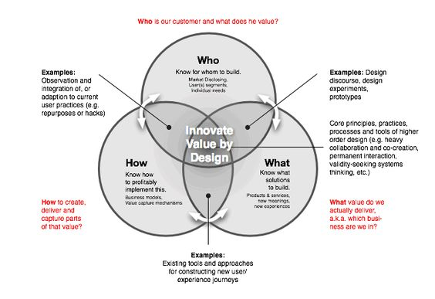
New Product Launch
Alarm for blind people
Music application for blind
Fire alarm for deaf
Key pointers
Identify primary, secondary user segment
Further segments in the user group
Gap in current product
Make no assumptions, clarify if any

Slide 14
Fire Alarm for Deaf
Clarifying questions
Any other disabilities, hearing aid?
Residential or commercial establishment
Any other characteristic of target segment – age/tech savvy etc.
Users
Primary: Deaf person in the building
Secondary
Other users in building
Fire department

Slide 15
Case Type 3: Product Improvement

Slide 16
Product Improvement
Software
Any application
Hardware
TV Remote
Computer mouse
Service
Car Rental Service
Customer Journey Approach

Slide 17
Case Type 4: Application Evaluation

Slide 18
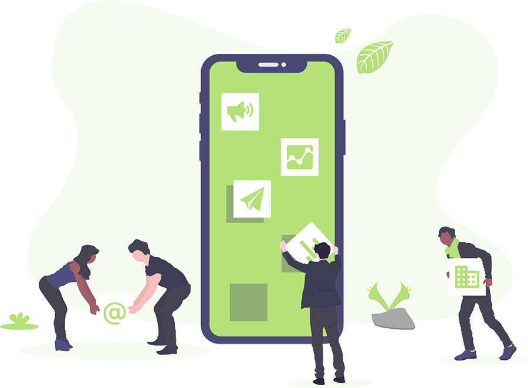
Fashion wearable shopping app
Acquisition:
Social media advertisement (click through rate); mail conversions; SEO, number of app downloads/month, number of signup/month etc.
Activation:
Avg. session length, number of product categories browsed, no. of clicks, no. of items viewed, avg time for 1st checkout, wish list frequency etc.
Retention:
Daily/Monthly active users (DAU/MAU), infrequent visitors, retention by push notification/ mail, churn out rate, cart abandonment, %age checkouts etc.
Revenue:
Avg. revenue generated per user, avg. order size per user, average return per user, CLV, CAC
Referral & satisfaction:
NPS score, App ratings, app reviews, complain rates, number of referral/user, etc.
The framework can be extended to an app feature also. Eg: Facebook Like

Slide 19
Types of Measurements for a PM
Quantitative metrics: User engagement & retention, traffic analysis
Report AARRR metrics, conversion percentage for sample users
Qualitative metrics: Usability testing, session monitoring
Watch what users do, find their problems & helpful solutions
Iterative metrics: A/B testing, Multi variate testing
What users do in one scenario v/s other, which methods work best
Comparative metrics: Monitoring & tracking competition
Comparing competitors activities against yours: key word traffic, user statistics

Slide 20
Case Type 5: Business Problems

Slide 21

Business Problems
Broadly, there are three approaches:
Using ‘CIRCLES’ framework
Using the knowledge of business model & value chain
Using customer journey

Slide 22
Thank You!
Happy Learning! ☺

